Slide 1
Wine
Neil Desai & Aditya Bhandari

Slide 2
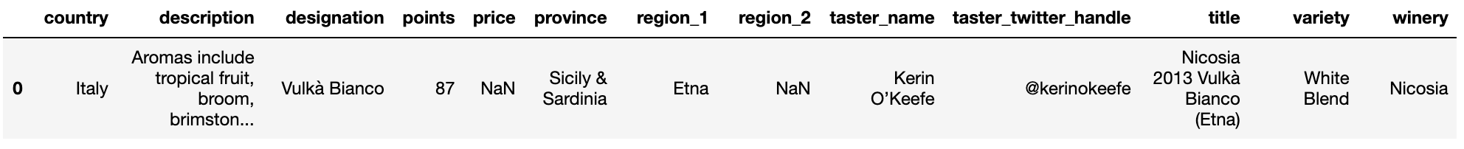
Dataset
Notes:
13 cols
119988 unique wines after cleaning the data
No wine scored below 80

Slide 3
Exploring Varieties of Wine
What variety of wine is most common?
What variety of wine is the best?
What variety of wine is most expensive?
Notes:
Intro with personal narrative

Slide 4
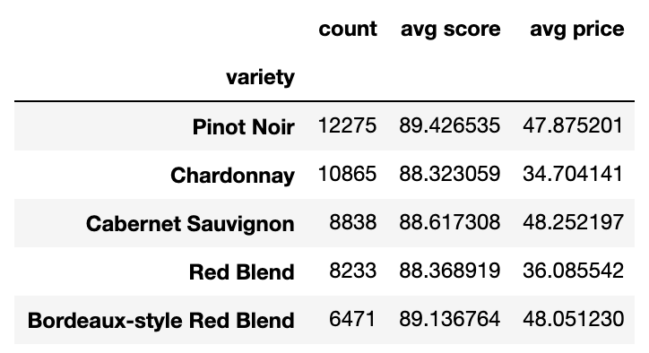
What Are the Most Common Varieties?

Slide 5
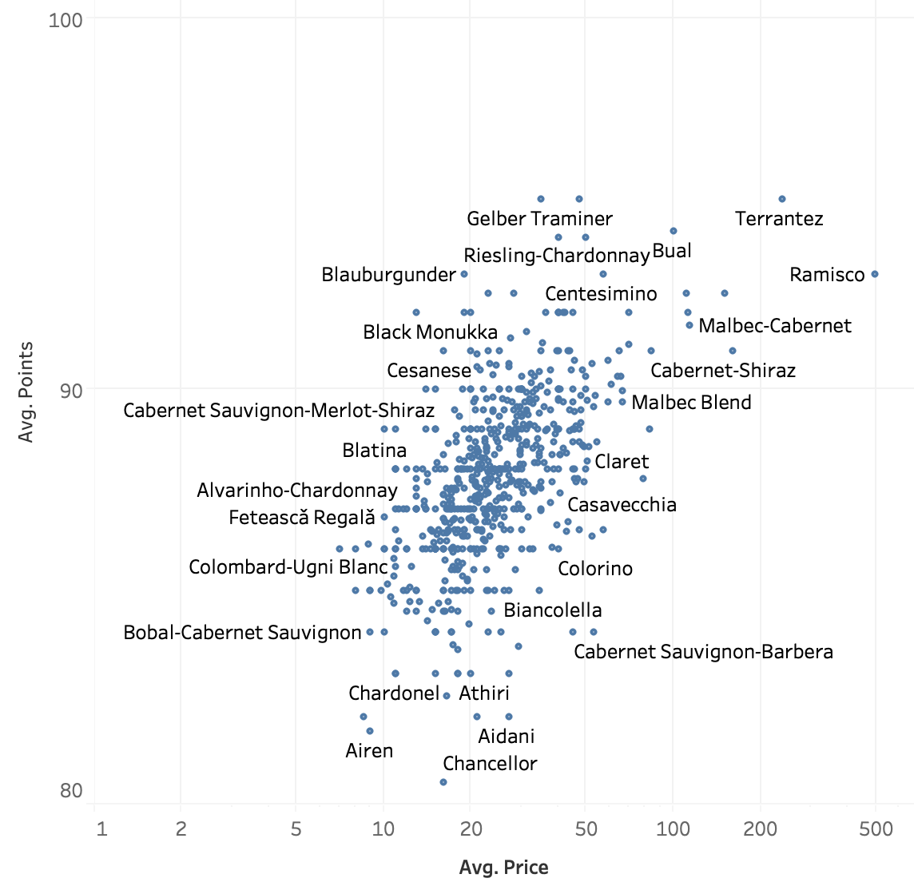
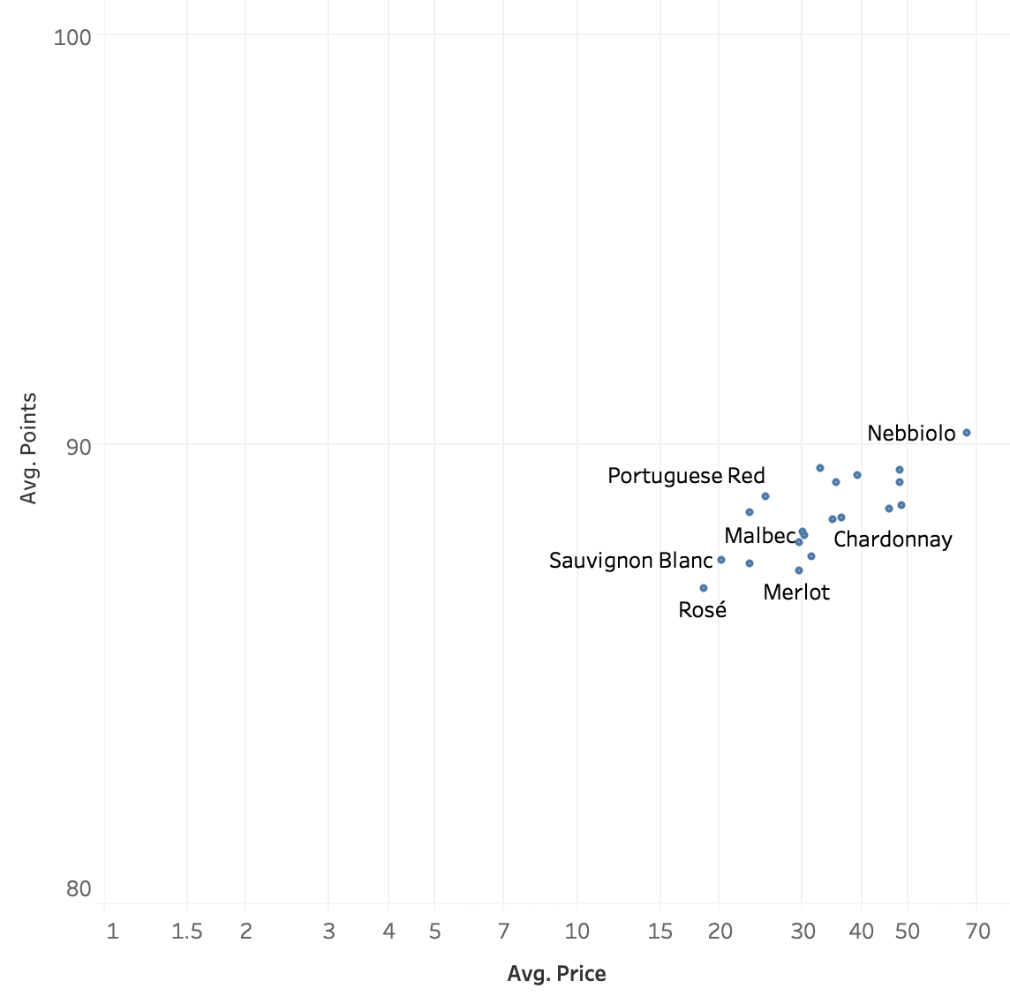
Avg. Price vs Avg. Points, By Variety
Top 20 Filtered
Notes:
Neil will mention possible price/points correlation or trend

Slide 6

Price vs Quality
Are the elitists and wine snobs right?
Is a higher price correlated with a higher quality wine?

Slide 7
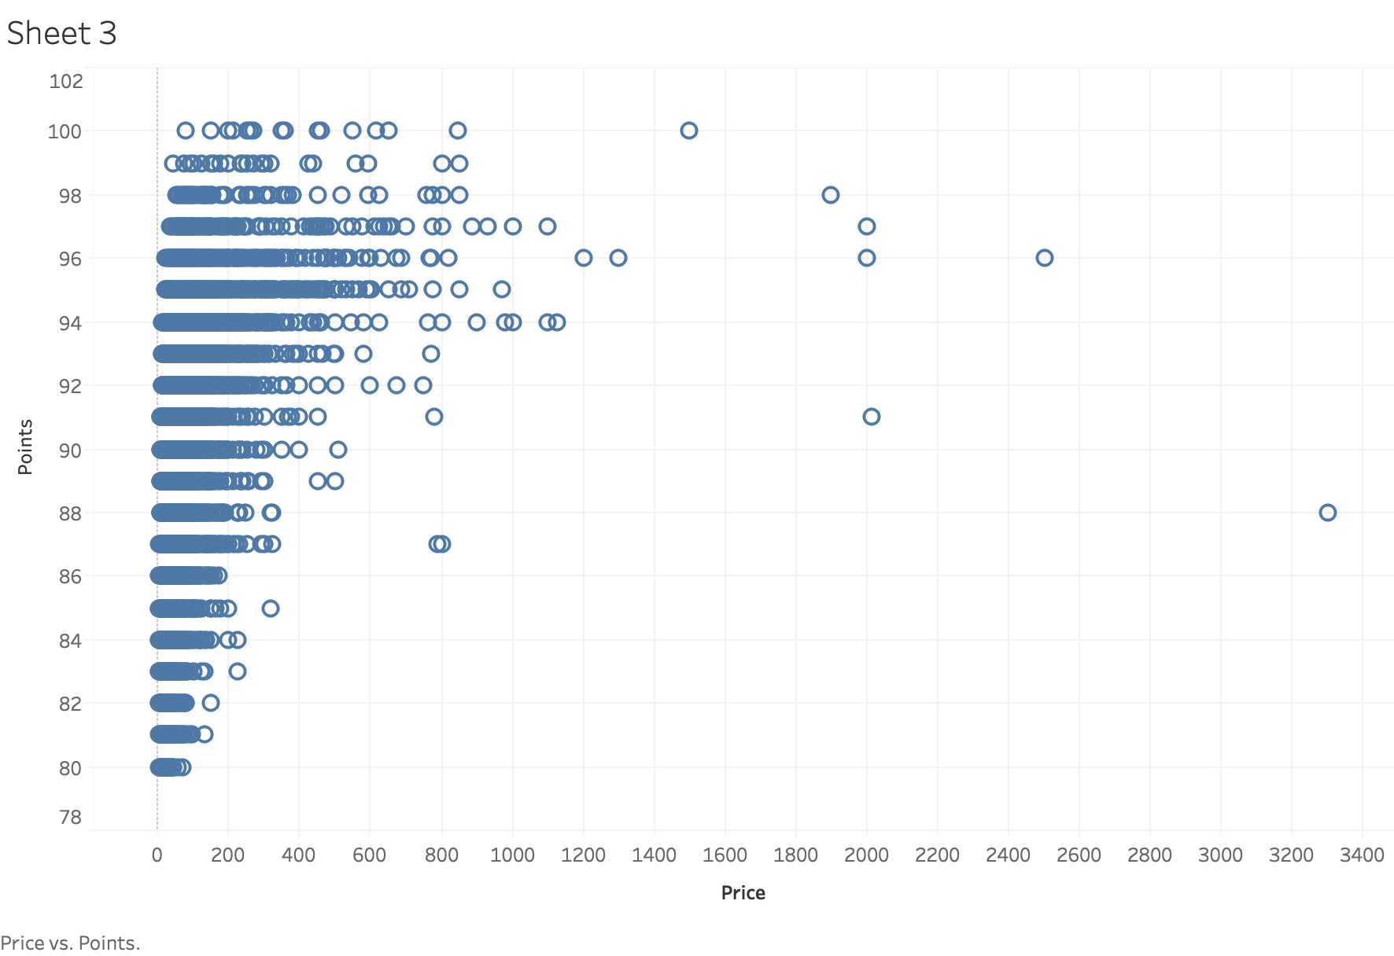
Price vs Points

Slide 8
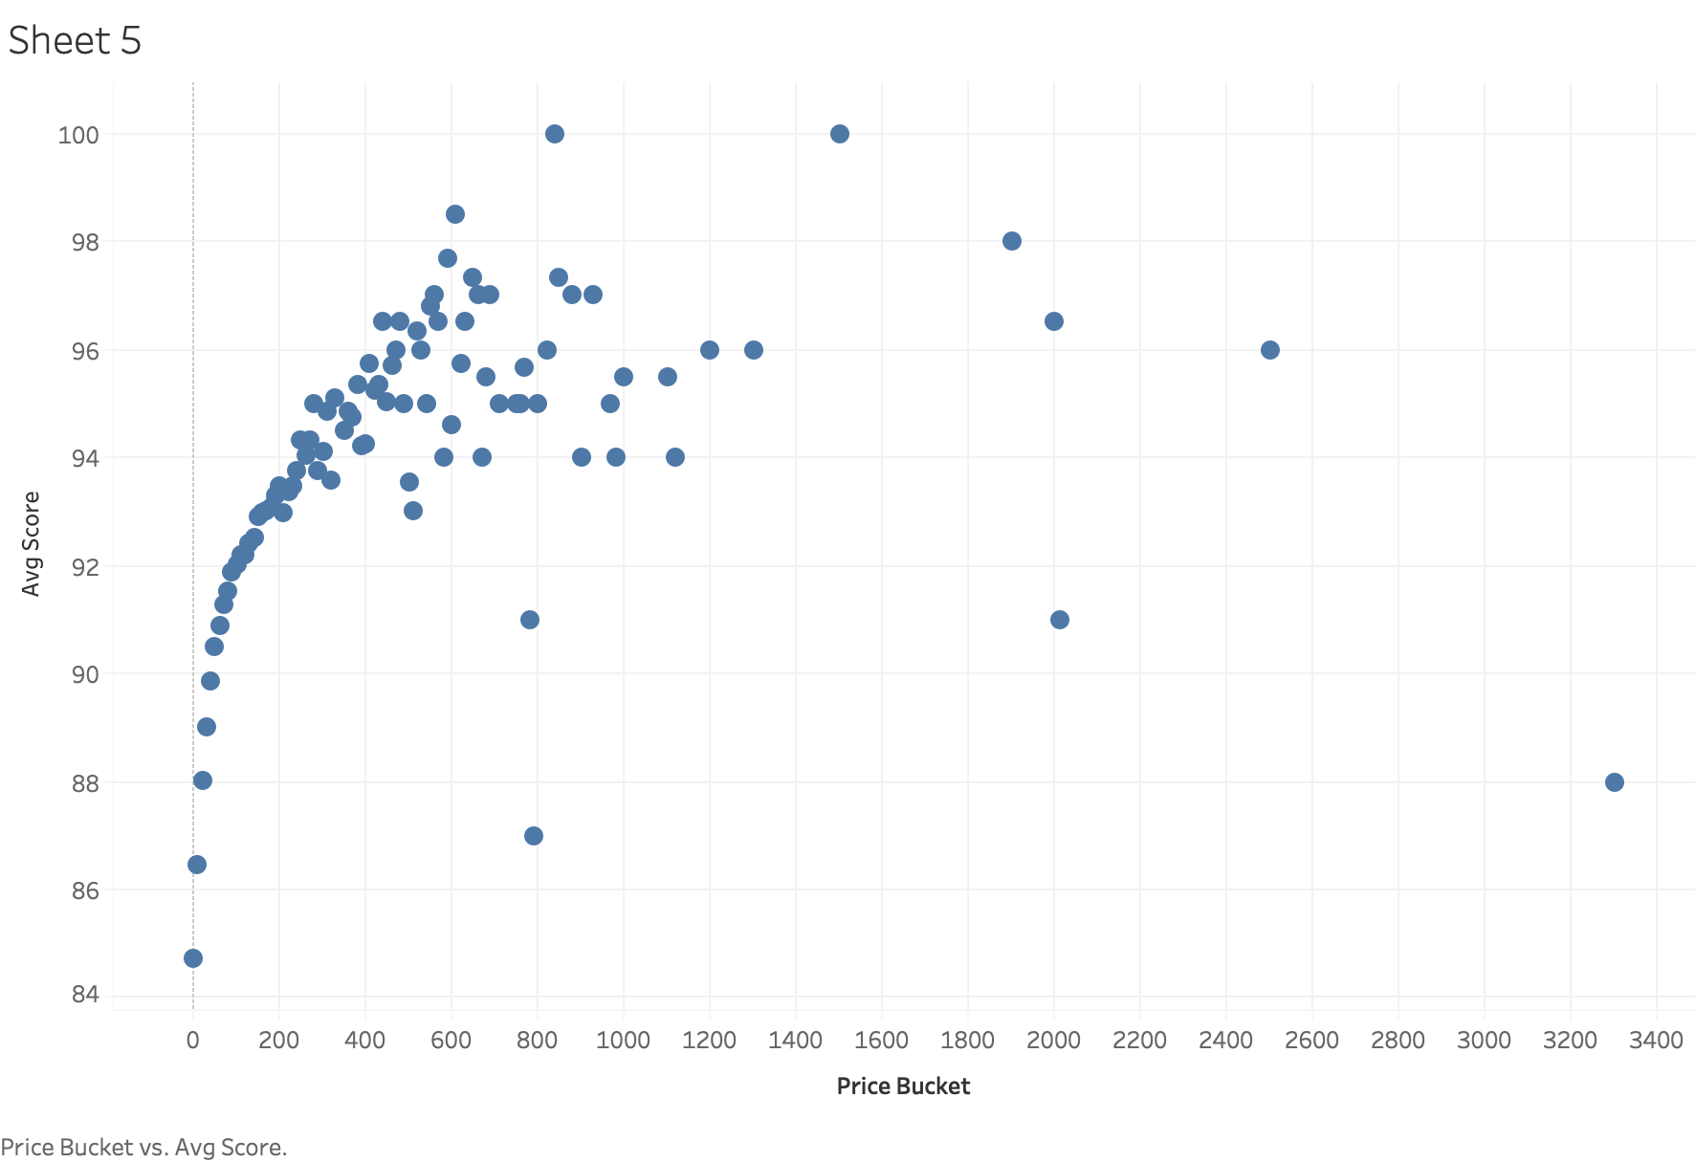
Price ($10 buckets) vs Points
Notes:
Château les Ormes Sorbet 2013 Médoc

Slide 9
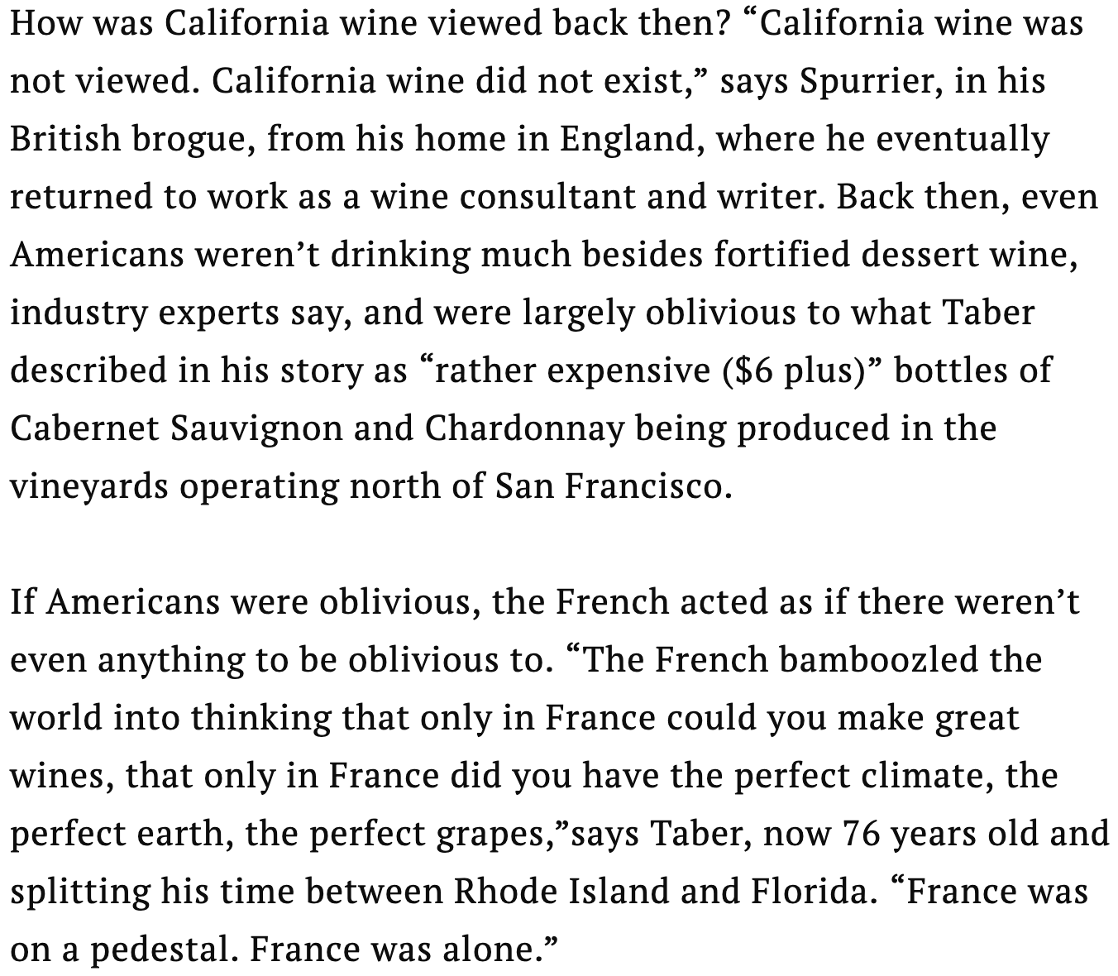
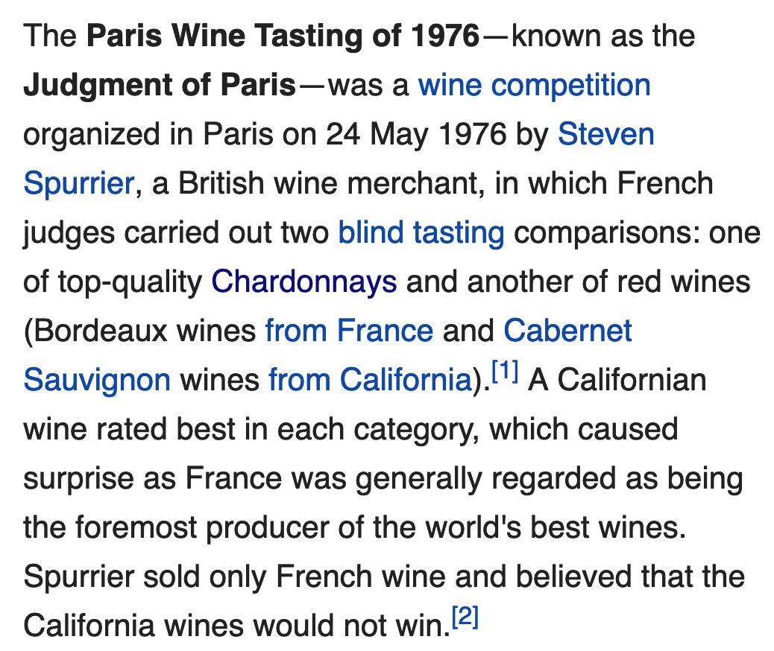
The History of Wine Snobbery
Notes:
Judgement of Paris, a wine competition held in Paris in 1976 where French wine conessiours blindly

Slide 10
Exploring Countries
What country has the best wine?
Which country has the most expensive wine?

Slide 11
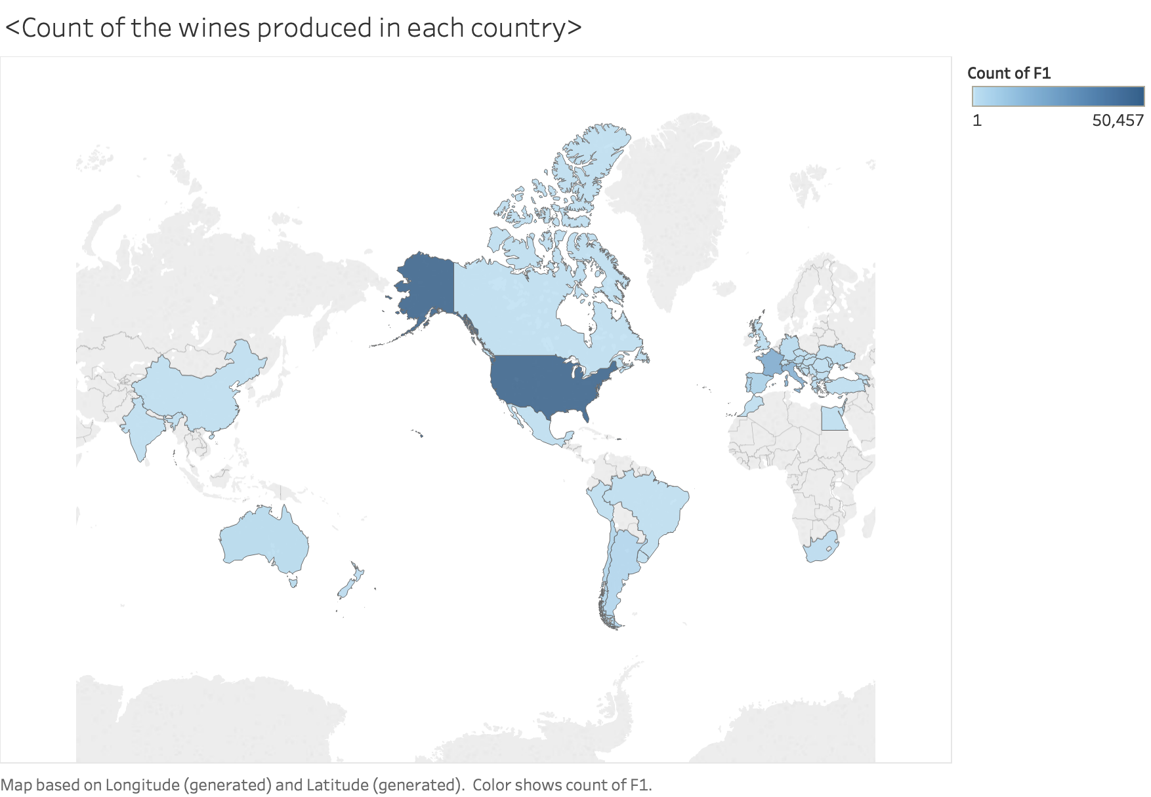
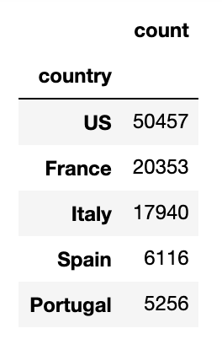
What Countries Produce the Most Wine?

Slide 12
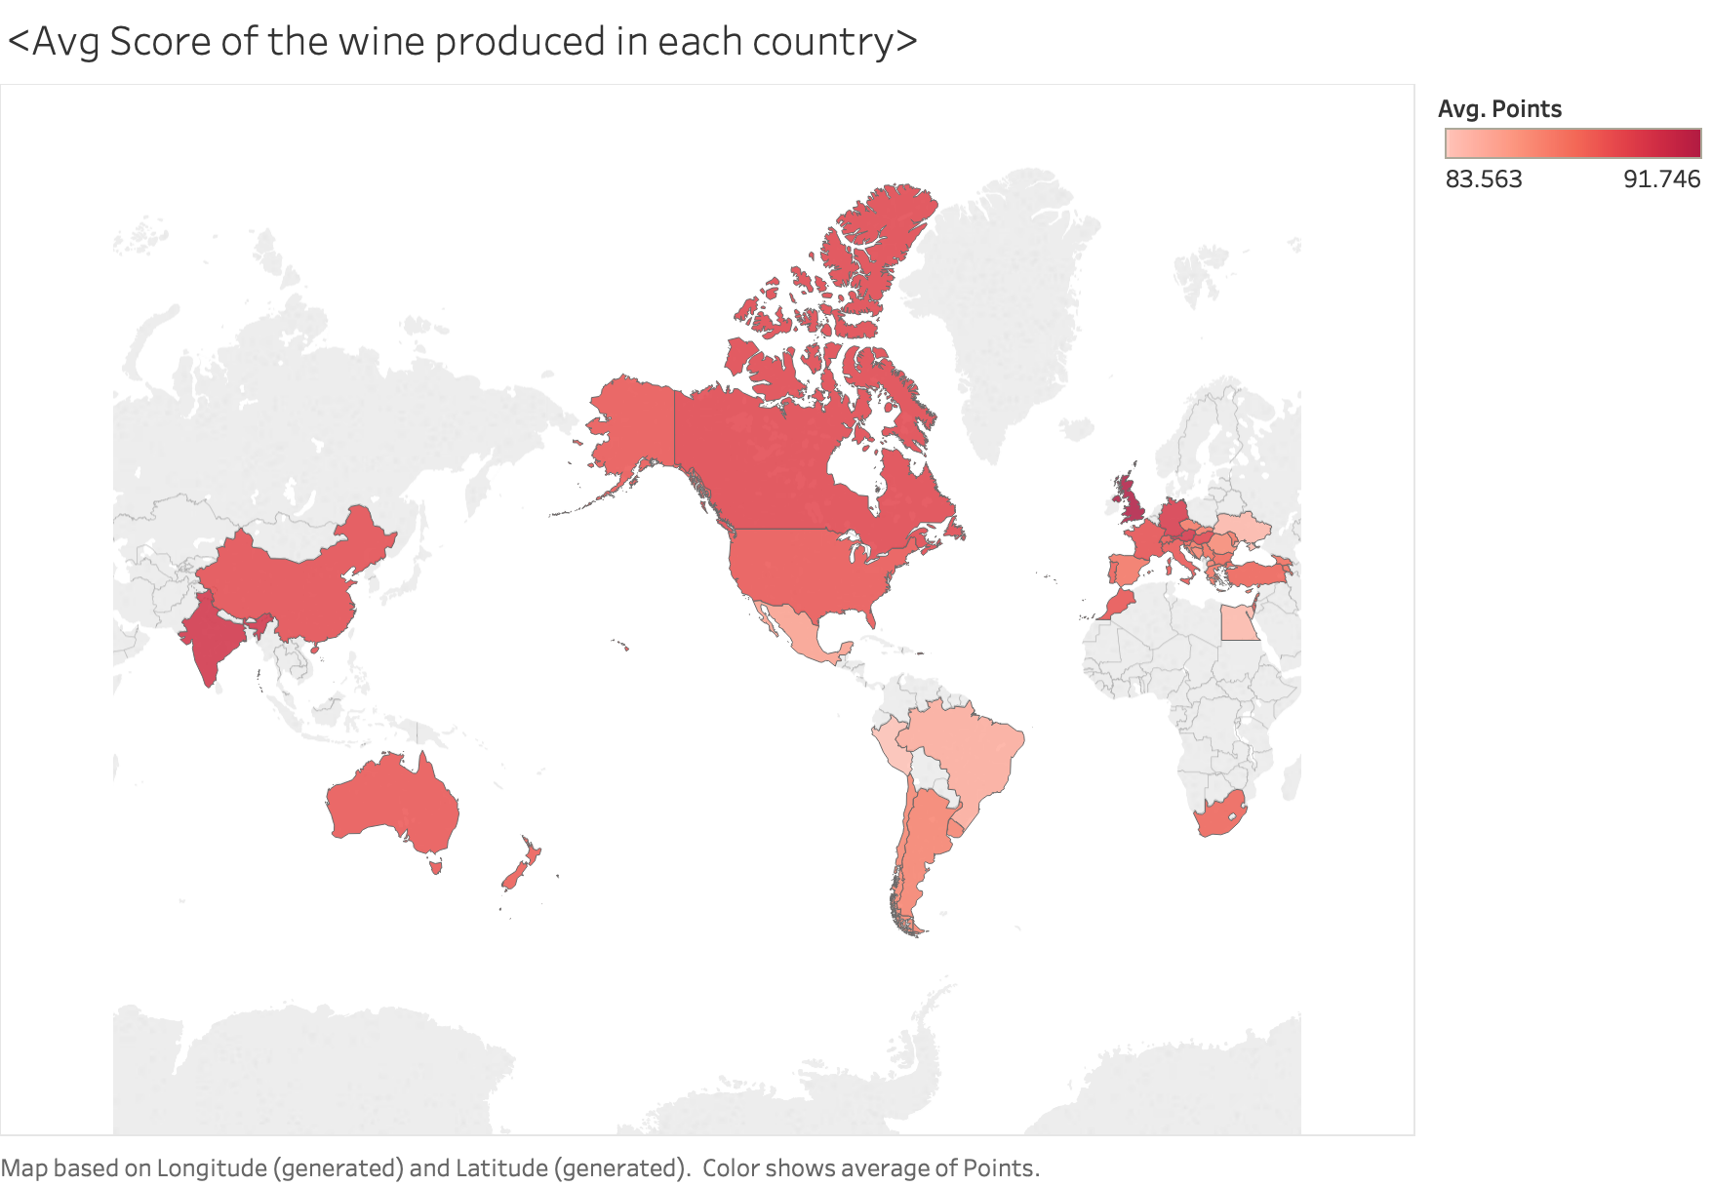
Average Score of Wine, By Country

Slide 13
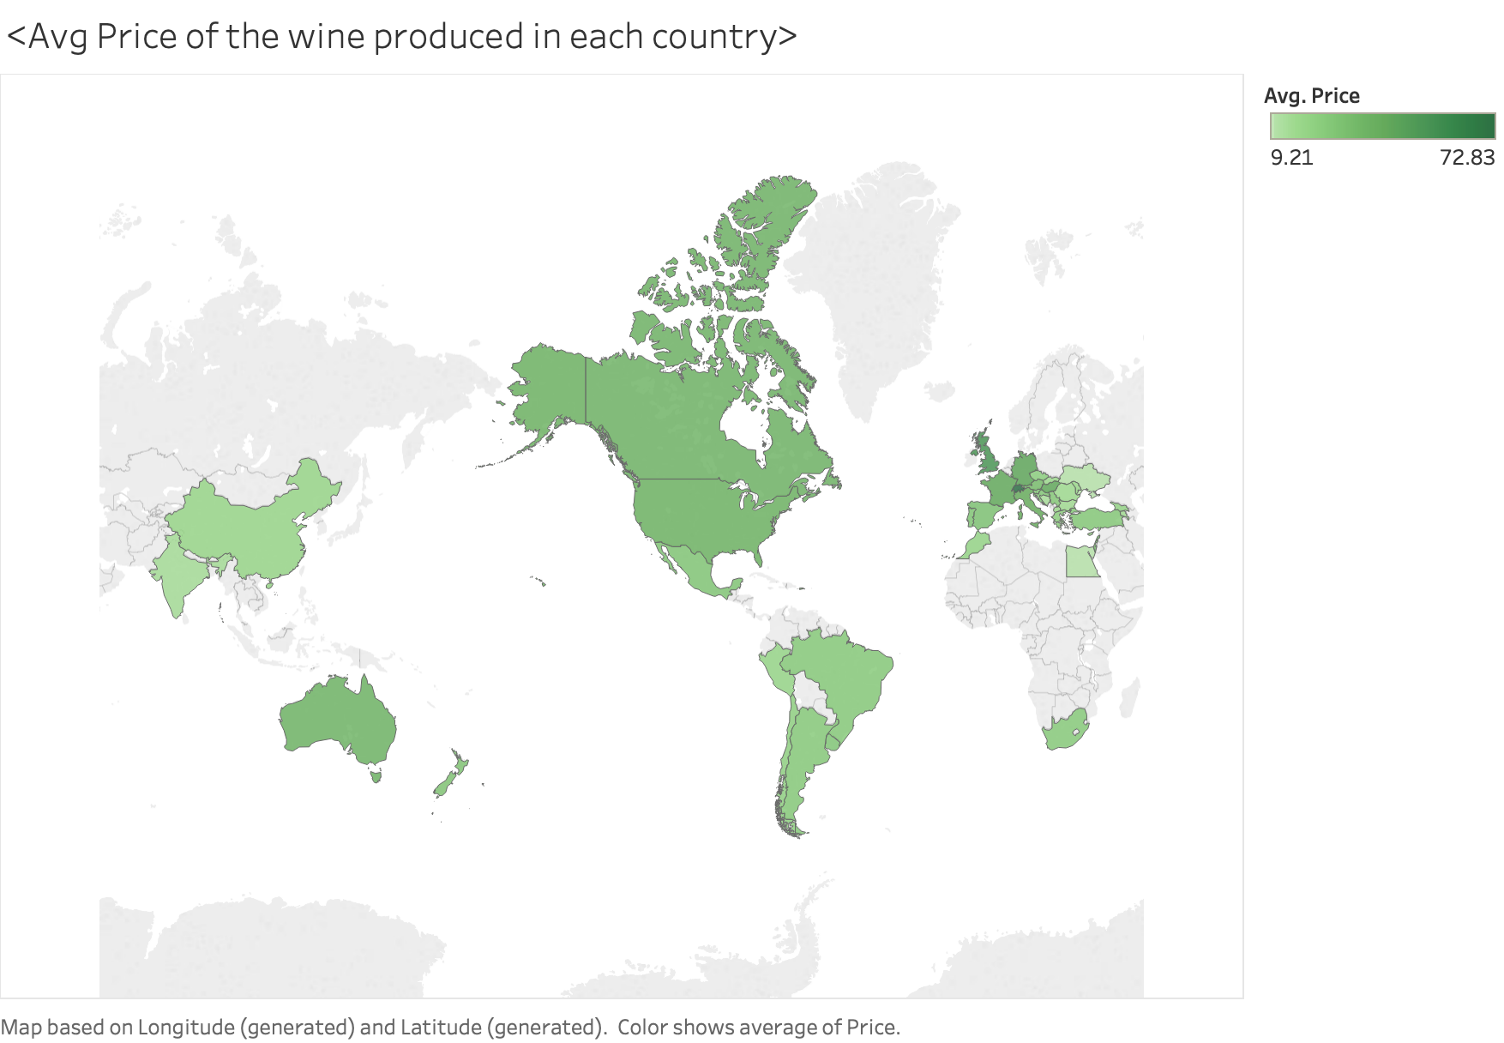
Average Price of Wine, By Country

Slide 14
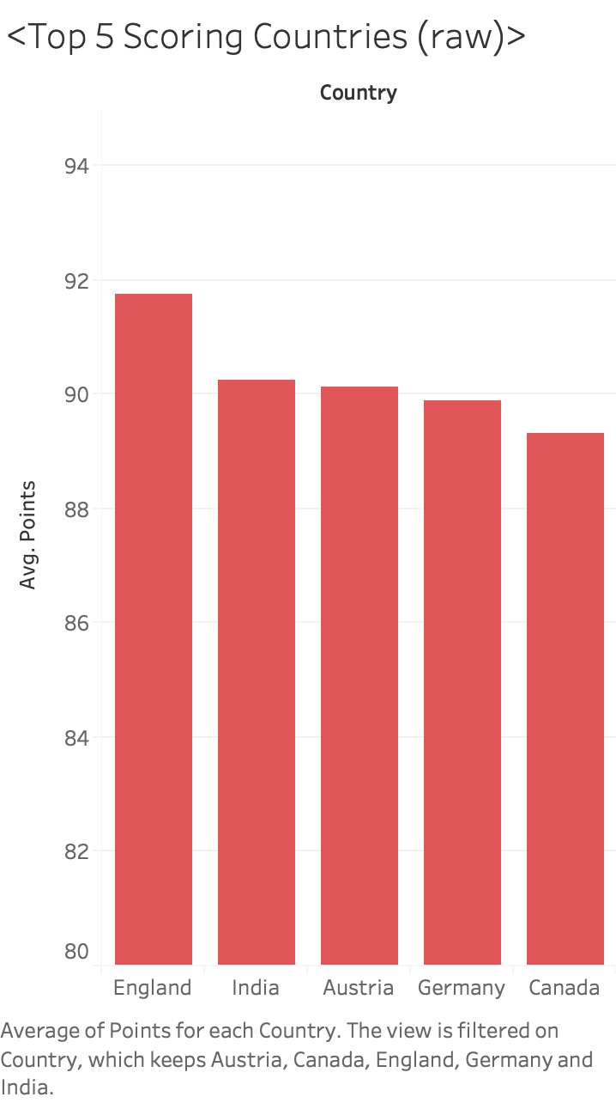
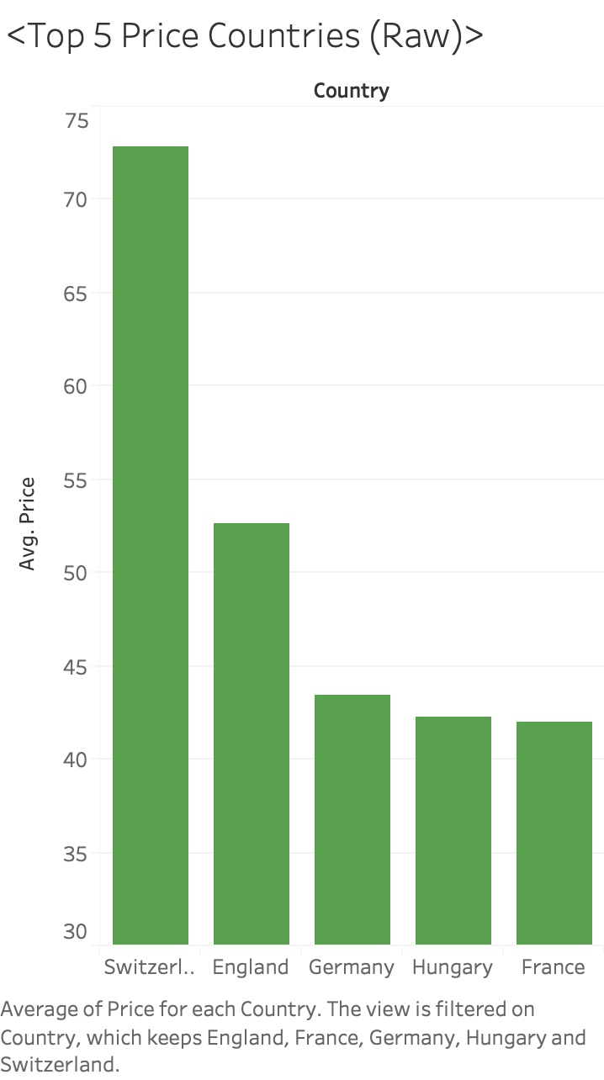
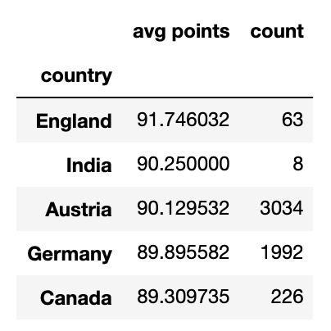
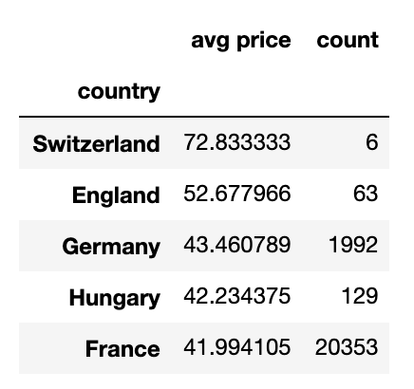
Notes:
China was 7th overall in points with one wine with a score of 89

Slide 15
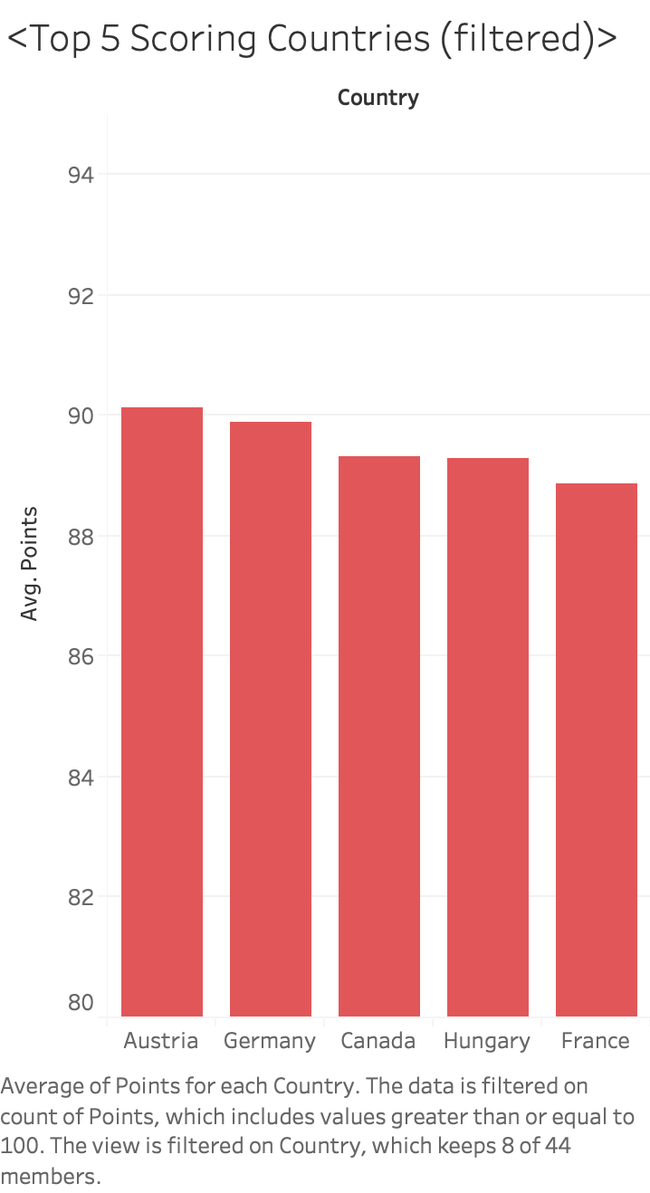
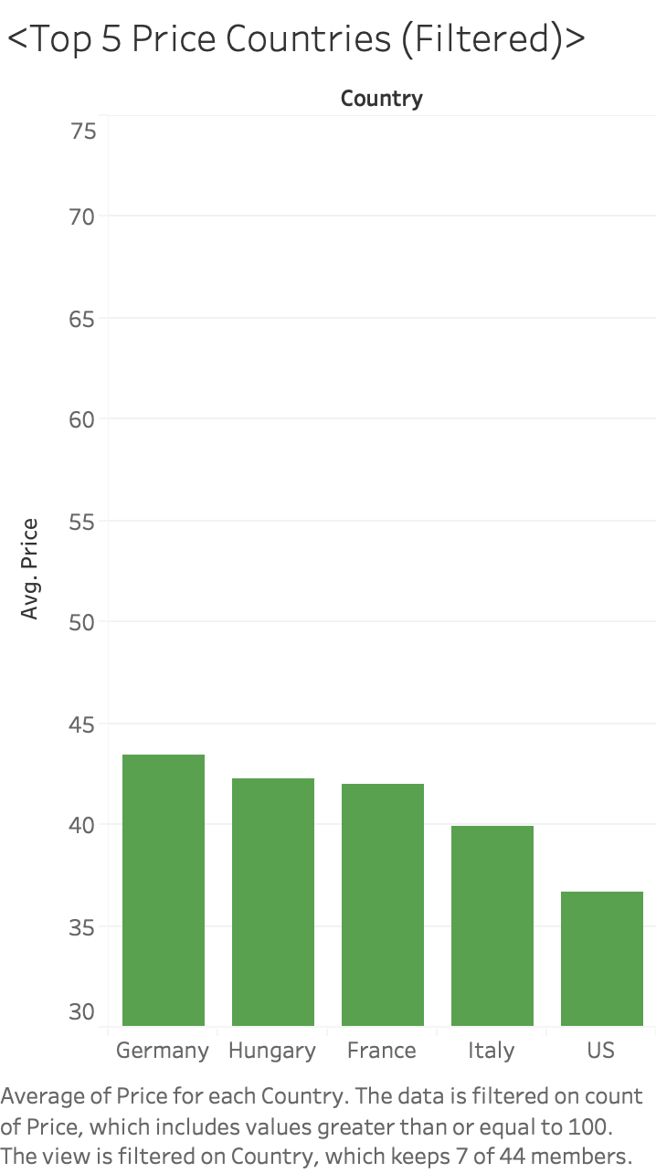

Slide 16
Conclusions
The most common varieties of wine tend to more expensive on average
Price correlated with points/quality—but only up to a certain point
Unexpected countries like Austria, Germany, and Canada took the lead in average score
Notes:
China was 7th overall with one wine with a score of 89

Slide 17
Problems / Future Work
Issues with dataset
Many obscure varieties with only one instance
Countries with very few wines
No age/year column, province region 1,2 were partially filled
Future Work
Use scraping techniques to extract the age
See if any relation between age, price, and score

